Slide 1
Deep Learning with Keras and TensorFlow
Notes:
Let's dive into the world of deep learning

Slide 2
Transformer Models for NLP
Notes:
This lesson is about transformer models for NLP

Slide 3

Apply self-attention mechanisms to analyze the importance of different words in a sentence for text processing
Utilize Transformer models to improve machine translation tasks, and explore how these models effectively manage long-range dependencies
Employ the Transformer architecture in natural language processing to develop more efficient sentiment analysis tools
Implement a Transformer model to recognize and translate languages, demonstrating the model’s ability to handle different linguistic inputs
Notes:
Read the learning objectives

Slide 4
Business Scenario
TelNet Global, a multinational telecommunications company, handles millions of customer interactions monthly across various channels, including social media, email, and live chat. The company faces challenges with response time and support quality due to the high volume of queries and the complexity of customer issues, ranging from billing problems to technical support for services.
Challenge:
TelNet Global needs a solution that can:
Automate responses to common queries to reduce the workload on human agents
Understand and route complex customer inquiries to the appropriate departments
Enhance customer experience by quickly providing accurate, context-aware responses
Reduce operational costs associated with customer support
Notes:
Read the business scenario, explain it to the learner, and discuss potential solutions that align with the lesson's content.
Discuss solution to the scenario:
Solution: Implementation of a Transformer-Based Model
TelNet Global decides to implement a transformer-based model to address these challenges, leveraging its ability to understand and generate human-like text from customer interactions.

Slide 5
Overview of Transformer Models
Notes:
Let’s first understand transformer models.

Slide 6
Introduction to Transformer Models
Transformer models are a type of deep learning architecture that leverages self-attention mechanisms to enable simultaneous processing of all sequence elements.
RNNs process data sequentially, requiring each step in a sequence to be handled one after another, unlike Transformers, which process elements
simultaneously.
Notes:
Instructor notes:
Encourage the learner to remember the structure of RNNs and then clarify how the transformer-based architecture, which is developed from RNNs, has quickly become critical in natural language processing and other machine learning tasks, thanks to its advanced design
RNNs process data sequentially, meaning each step in a sequence must be processed one after the other. This sequential processing inherently limits the speed of training and inference because each step depends on the output of the previous step, making it hard to fully utilize modern parallel computing architectures.
Transformers, on the other hand, use self-attention mechanisms that allow them to process all parts of the sequence simultaneously. This parallel processing capability significantly speeds up training and inference as it does not require sequential data processing, enabling the model to learn dependencies between elements in the sequence more directly and efficiently
Let's move on to the next slide to explore the self-attention mechanism in more detail:

Slide 7

Understanding Self-Attention
Self-attention, a key component in Natural Language Processing (NLP), enables the network to focus on specific words or phrases in a sentence to improve context understanding.
Example:
While reading a novel, you simultaneously focus on the current page and recall earlier events, characters, and clues.
This context helps you understand the story better and predict future events.
You are reading a mystery novel.
Notes:
This slide is self-explanatory

Slide 8
Mechanics Behind Self-Attention
The self-attention layer calculates three vectors from each encoder's input vector:
Key Vector (K): This vector scores the attentiveness of each word.
2
Query Vector (Q): This vector scores each word regarding the extent of attention it needs.
Value Vector (V): This vector represents the actual word content, which generate the final output.
1
3
Notes:
This slide is self-explanatory

Slide 9
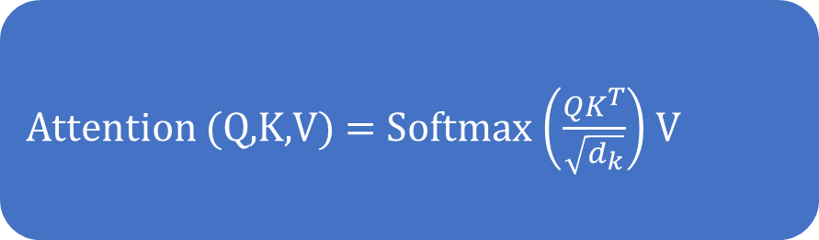
Mechanics Behind Self-Attention
During training, vectors are iteratively trained and updated.
The following equation defines the attention score for each input word.
Attention (Q,K,V) = Softmax $\left(\frac{{QK}^{T}}{\sqrt{d_{k}}}\right)$ V
Notes:
Instructor notes:
The self-attention mechanism calculates the attention scores for each word in the input sequence. Explain the formula to the learners:
Q, K, V represent the query, key, and value matrices derived from the input embeddings.
${QK}^{T}$ represents the dot product of the query and key matrices, which provides a score that measures how much attention each word should pay to every other word in the sequence.
$\sqrt{d_{k}}$​​ is a scaling factor (where $d_{k}$is the dimension of the key vectors), used to avoid overly large values in the dot product that could lead to difficulties with gradients during training.
The softmax function is applied to normalize these scores so that they sum to 1, making them interpretable as probabilities.

Slide 10

Understanding Mechanics Behind Self-Attention: Example
A person at a party tries to decide who to listen to in a crowded room. Imagine each person at the party has a story to tell, but not all stories are equally important to that person. So, everyone needs to decide how much attention each speaker should get.
Whom to pay attention to?
Notes:
This slid is self explanatory

Slide 11
Understanding Mechanics Behind Self-Attention: Example
Understand how self-attention works in this analogy:
Listening: Each person (data point or word in a sentence) listens to the stories (inputs) of others in the room (sequence).
Scoring: Everyone assigns a score to each storyteller based on how relevant each story is to their current interests or the context of the conversation (query-key matching).
Focusing: The focus is more on the stories with higher scores (these get more attention).
Combining: Everyone creates a summary of what's important from all these stories, weighted by how much attention was paid to each (weighted sum of values).
Notes:
Instructor notes:
Read this after going through example:
So, self-attention allows the model to dynamically focus on and combine information from all parts of the input based on relevance and context, which helps it understand and process the entire sequence more effectively.
Discuss the question: what is the advantage to transformer model using self attention mechanism?

Slide 12

Transformer Models: Advantage
Transformer models can excel at capturing long-range dependencies through self-attention mechanisms, making them ideal for tasks such as machine translation and document summarization.
Prior models, such as RNNs and LSTMs, had challenges dealing with long-range sentence dependencies, which were resolved by transformer models.
Notes:
Instructor notes:
Let's explore what long-range dependencies are and how Transformer models handle them more effectively than traditional models like RNNs and LSTMs, using an example

Slide 13
Long-Range Dependencies
Consider the following sentence:
  “Frenny likes to play basketball; he is good at dunking.”
Frenny is the subject.
he is a pronoun referring to Frenny.
RNNs and LSTMs are generally proficient at establishing such associations, especially when dealing with shorter sentences.
Notes:
This slide is self-explanatory

Slide 14
Long-Range Dependencies
Consider a bigger paragraph:
“Lara is a cook at McTown French Fries. She’s been working there for three years now. The place immediately gained fame once she joined. Nobody knew of its existence until she joined it. She made good friends with other cooks and learned to cook various new dishes, which customers enjoyed at that place.”
Lara
Pronouns of Lara
McTown French Fries
Pronouns of McTown French Fries
Longer sequences or paragraphs can be challenging for traditional sequence models like RNNs and LSTMs to process.
Notes:
Instructor notes:
Traditional sequence models like RNNs (Recurrent Neural Networks) and LSTMs (Long Short-Term Memory networks) struggle with processing longer sequences or paragraphs primarily due to two key issues: the vanishing gradient problem and computational inefficiency.
Vanishing Gradient Problem: In neural networks, gradients are used during backpropagation to update the weights of the network to minimize the error in predictions. In RNNs and LSTMs, as the sequence length increases, these gradients can become exceedingly small (vanish) or very large (explode) as they are propagated back through each timestep of the sequence. When gradients vanish, the weights are not updated effectively, leading to a loss of information about the earlier parts of the sequence. This makes it difficult for these models to learn and maintain dependencies between distant elements in long sequences.
Computational Inefficiency: RNNs and LSTMs process data sequentially, meaning each step must wait for the previous steps to be processed. This sequential dependency limits parallelization and makes the training and inference processes slower, particularly as sequence lengths increase. Longer sequences require more computational time and resources, which can become impractical for very long texts or datasets.

Slide 15

Long-Range Dependencies
The algorithms (RNNs and LSTMs) often struggle to determine the subject of a sentence when processing a whole paragraph.
Eventually, it loses its association with other subjects in the input.
Transformer models retain the context of pronoun references and exhibit strong proficiency in recognizing the grammar of provided sentences.
Notes:
Instructor notes:
Transformer models address the limitations of traditional sequence models like RNNs and LSTMs primarily through the use of self-attention mechanisms and layer-wise processing, which effectively solve the issues of vanishing gradients and computational inefficiency

Slide 16

Applications of Transformer Models
Natural language processing
Speech recognition
Image recognition
Transformer models are commonly used in NLP for tasks like machine translation, text summarization, sentiment analysis, and question-answering.
Recommender systems
Reinforcement learning
Drug discovery
Notes:
Instructor notes:
Language translation
Transformers efficiently translate text from one language to another while preserving contextual meaning.
Text classification
They can categorize or classify text into predefined groups based on content.
Language generation
They can generate human-like, contextually relevant text.
Question answering
Transformers can parse context to provide accurate answers to specific questions in natural language processing.

Slide 17
Applications of Transformer Models
Natural language processing
Speech recognition
Image recognition
The transformer model is employed in automatic speech recognition systems to convert spoken language into written text.
Recommender systems
Reinforcement learning
Drug discovery
Notes:
This slide is self-explanatory

Slide 18
Applications of Transformer Models
Natural language processing
Speech recognition
Image recognition
The transformer model is adapted for computer vision tasks such as image classification, object detection, and image captioning.
Recommender systems
Reinforcement learning
Drug discovery
Notes:
This slide is self-explanatory

Slide 19
Applications of Transformer Models
Natural language processing
Speech recognition
Image recognition
The transformer model is applied in recommendation systems to provide personalized recommendations based on user preferences and behavior.
Recommender systems
Reinforcement learning
Drug discovery
Notes:
This slide is self-explanatory

Slide 20
Applications of Transformer Models
Natural language processing
Speech recognition
Image recognition
Transformer models are used in reinforcement learning to enhance decision-making in sequential tasks like game-playing and robot control.
Recommender systems
Reinforcement learning
Drug discovery
Notes:
This slide is self-explanatory

Slide 21
Applications of Transformer Models
Natural language processing
Speech recognition
Image recognition
Transformer models are utilized in drug discovery to predict molecular properties, design new molecules, and speed up the drug development process.
Recommender systems
Reinforcement learning
Drug discovery
Notes:
This slide is self-explanatory

Slide 22
Architecture of the Transformer Model
Notes:
Let’s understand the architecture of the transformer model

Slide 23
Transformer Model Architecture
At a fundamental level, a transformer architecture comprises two primary components: an encoder and a decoder.
Output (English)
I am a student
Encoder
Decoder
Encoder
Decoder
Encoder
Decoder
Encoder
Decoder
Encoder
Decoder
Encoder
Decoder
Input
(French)
Je suis étudiant
Notes:
Instructor notes:
The diagram describes a visual representation of a Transformer model being used for language translation, specifically translating from French to English.
Let’s understand working:
Encoders: The sequence of encoder layers processes the input sentence. Each encoder layer refines the representations of the input words, incorporating contextual information from the entire sentence. Typically, these layers use self-attention mechanisms and feed-forward networks to understand the relationships between all words in the input, irrespective of their distance from each other.
Decoders: Correspondingly, the sequence of decoder layers generates the output translation one word at a time. Starting with an initial token (often something like <start>), each decoder layer uses:
Self-Attention: To ensure coherence and context within the output itself, focusing on what has been generated so far.
Encoder-Decoder Attention: To focus on relevant parts of the input sentence, drawing directly from the encoders' outputs. This mechanism helps the decoder determine which words in the French sentence are most relevant when predicting the next word in English.

Slide 24
Transformer Model Architecture
Working of encoder and decoder
The encoder processes input sequences and captures contextual information, employing self-attention to integrate information across the entire sequence.
The decoder generates an output sequence and predicts the next word based on context.
The architecture ensures accurate and coherent sequence processing and generation.
Notes:
This slide is self-explanatory

Slide 25
Transformer Model Architecture
In transformer architecture, multiple identical encoders and decoders layer for sequence-to-sequence processing, as shown below:
Output
Probabilities
Softmax
Linear
Add & Norm
Feed
Forward
It is common to have six or more of these identical layers.
The stacking of these layers enables effective information capture and generation in transformer models.
Add & Norm
Add & Norm
Multi-Head
Attention
Feed
Forward
Nx
Nx
Add & Norm
Add & Norm
Masked
Multi-Head
Attention
Multi-Head
Attention
Positional
Encoding
+
+
Positional
Encoding
Input
Embedding
Output
Embedding
Inputs
Outputs
(Shifted right)
Source: Vaswani, Ashish, Noam Shazeer, Niki Parmar, Jakob Uszkoreit, Llion Jones, Aidan N. Gomez, Łukasz Kaiser, and Illia Polosukhin. "Attention is all you need." Advances in neural information processing systems 30 (2017).
Notes:
Instructor notes:
The architecture of a transformer model typically consists of multiple identical encoder and decoder layers stacked on top of each other. A common configuration may involve six or more of these layers, allowing for effective sequence processing and generation.

Slide 26
Working of Transformer in Language Translation
Notes:
Let’s look at how transformer with text generation work

Slide 27
Transformer Working: Encoder
An example of language translation to understand the workings of a transformer:
Input: Je suis étudiant
Input processing: The Transformer model begins by taking an input, in this case, ‘Je suis étudiant’ (I am a student in French). Each word is first converted into a vector through an embedding process.
Positional encoding: After embedding, positional encoding is added to each word vector. This step is crucial as it injects information about the position of each word in the sequence into its vector representation, allowing the model to recognize word order, which is essential for understanding the syntax and semantics of the input sentence.
Each encoder has two layers:
Self-attention mechanism
Feed-forward neural network
Notes:
This slide is self-explanatory

Slide 28
Transformer Working: Encoder
Each encoder has two layers:
Self-attention mechanism
Passing through encoders: The word vectors, now enhanced with positional information, pass through multiple layers of encoders. Each encoder layer processes the vectors, refining and enriching the representations with context from the entire sentence. This process leverages self-attention and feed-forward neural networks within each layer.
Feed-forward neural network
Notes:
This slide is self-explanatory

Slide 29
Transformer Working: Decoder
A decoder has three layers:
Receiving encoder outputs: The decoder begins its process by receiving the entire sequence of outputs from the encoder. These outputs contain encoded information about every word in the input sequence, providing a comprehensive context that the decoder will use to generate the translation.
Output sequence initialization: The decoder generates the output sequence by receiving a special start token. This token serves as the initial input for the decoder layers.
Feed-forward
Encoder-decoder attention
Self-attention
Notes:
This slide is self-explanatory

Slide 30
Transformer Working: Decoder
A decoder has three layers:
Self-attention mechanism: Each decoder layer first applies a self-attention mechanism with a restriction. This self-attention only allows each position in the decoder to attend to earlier positions in the output sequence. This ensures that the predictions for each word are dependent only on the known previous words, preserving the auto-regressive property necessary for coherent generation. This mechanism helps the decoder understand the context within the output sequence itself, enhancing the flow and grammatical structure of the translation.
Feed-forward
Encoder-decoder attention
Self-attention
Notes:
This slide is self-explanatory

Slide 31
Transformer Working: Decoder
Encoder-decoder attention: After processing through its self-attention layer, each decoder layer uses an encoder-decoder attention mechanism. This crucial layer allows the decoder to focus on relevant parts of the input sequence for each word being generated in the output. By attending to the encoder's outputs, the decoder effectively utilizes the input sequence's contextual information, ensuring that the generated translation is semantically aligned with the input.
Feed-Forward Neural Networks: Like the encoder, each decoder layer includes a position-wise feed-forward neural network. This network processes the output of the attention mechanisms and produces the intermediate representations that generate the next word in the output sequence.
A decoder has three layers:
Feed-forward
Encoder-decoder attention
Self-attention
Notes:
This slide is self-explanatory

Slide 32
Transformer Working: Decoder
A decoder has three layers:
Output generation: The final layer in the decoder transforms the intermediate representations into logits, which pass through a softmax layer to form a probability distribution over the possible output words. The word with the highest probability is selected as the next word in the output sequence.
Repeat the process: This process repeats for each word in the output sequence until the decoder generates an end-of-sequence token, signaling the completion of the output generation.
Feed-forward
Encoder-decoder attention
Self-attention
Notes:
This slide is self-explanatory

Slide 33
Introduction to BERT Model
Notes:
Let’s now look at BERT Model and its use case

Slide 34
BERT Model
BERT stands for Bidirectional Encoder Representations from Transformers.
It is a transformer model without decoder modules and only has a trained encoder stack.
Encoder
Encoder
Encoder
Encoder
Encoder
The transformer encoder tends to read the entire sequence of words at once.
It learns the context of the given input rather than learning it in sequence. It is called contextual learning.
Notes:
Instructor notes:
The Transformer is a more general architecture that includes both encoding and decoding capabilities, ideal for tasks like translation. BERT, on the other hand, is an application of the Transformer's encoding mechanism, optimized for understanding the context of language in a bidirectional way, and adaptable to a broad range of NLP tasks.

Slide 35
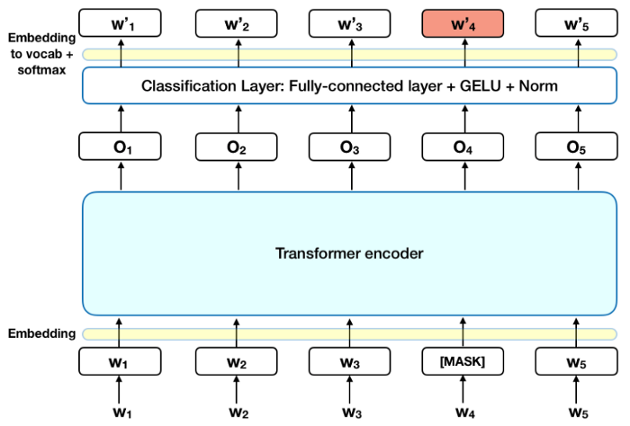
BERT and Masked Language Modeling
A Masked Language Model (MLM) is a type of language model used in the pre-training of models like BERT (Bidirectional Encoder Representations from Transformers). The working of an MLM is as shown below:
Source: Lappin, Shalom. Deep learning and linguistic representation. Chapman and Hall/CRC, 2021.
Notes:
Instructor notes:
BERT uses the Transformer model's encoder for its underlying architecture. The Transformer model's self-attention mechanism allows BERT to weigh the importance of different words in the sentence when encoding each word. This provides a context-rich representation for each word that takes into account the interdependencies between words, regardless of their positions in the sentence.

Slide 36
BERT and Masked Language Modeling
In Masked Language Modeling (MLM), 15% of the words are replaced with a MASK token before feeding the sequence of words into BERT.
The model attempts to predict the original values of the masked words by leveraging the contextual information available.
Notes:
Instructor notes:
Masked Language Modeling is a pre-training task used to train BERT. Here’s how it works:
Masking: In the MLM task, 15% of the input tokens are randomly masked. For example, in the sentence "The quick brown fox jumps over the lazy dog," words like "brown" and "fox" might be replaced with a [MASK] token, so it becomes "The quick [MASK] [MASK] jumps over the lazy dog."
Contextual Prediction: The goal of the model is then to predict the original value of the masked words based solely on their context. This means the model must understand the sentence structure, grammar, and vocabulary effectively.
Bidirectional Training: Unlike unidirectional models that only predict each word based on the previous words, BERT’s use of MLM allows it to integrate context from both the left and the right side of a masked token. This is crucial for deeply understanding the language.

Slide 37
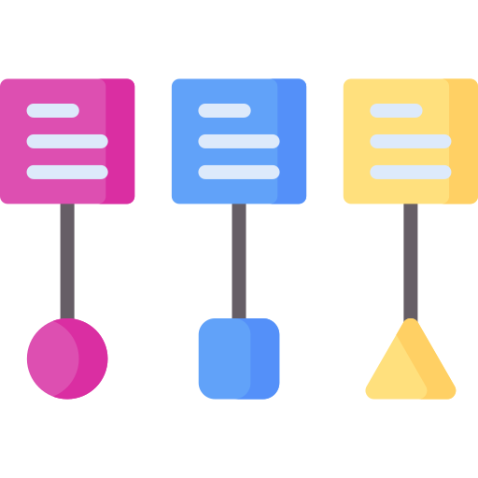

Use Cases for BERT
Text classification: It identifies text characteristics like fraud detection.
Text generation: It generates text, specifically chatbot responses.
Notes:
Instructor notes:
Text classification: BERT can be utilized to determine the nature of text, such as distinguishing between fraudulent and legitimate content.
Text generation: BERT can be applied to generate text, which is particularly useful for applications like chatbots where generating conversational responses is required.

Slide 38


Use Cases for BERT
Search engine optimization: It improves search relevance for user queries.
Question-answering (Q&A) system: It helps in accurate Q&A responses.
Notes:
Instructor notes:
Search engine optimizations: BERT can help enhance search engine results by improving the understanding of user queries and matching them with relevant content.
Question-answering (Q&A) systems: BERT can be employed in setting up customer care support bots or other Q&A systems to provide accurate and helpful responses to user queries.

Slide 39
Introduction to GPT Model
Notes:
Let’s now look at GPT, a transformer model built only from decoders.

Slide 40
GPT Model
GPT stands for Generative Pre-trained Transformer.
It is a transformer model without encoder modules and only has a trained decoder stack.
Decoder
Decoder
Decoder
Decoder
Decoder
The decoder uses masked self-attention, so each word can see only the words before it.
It learns to predict the next word from the words before it. It is called autoregressive (causal) language modeling.
Notes:
Instructor notes:
Contrast GPT with BERT: BERT keeps only the encoder stack and reads text in both directions, while GPT keeps only the decoder stack and reads text from left to right.
Because each word can only see the words before it, GPT is naturally suited to generating text one word at a time.

Slide 41
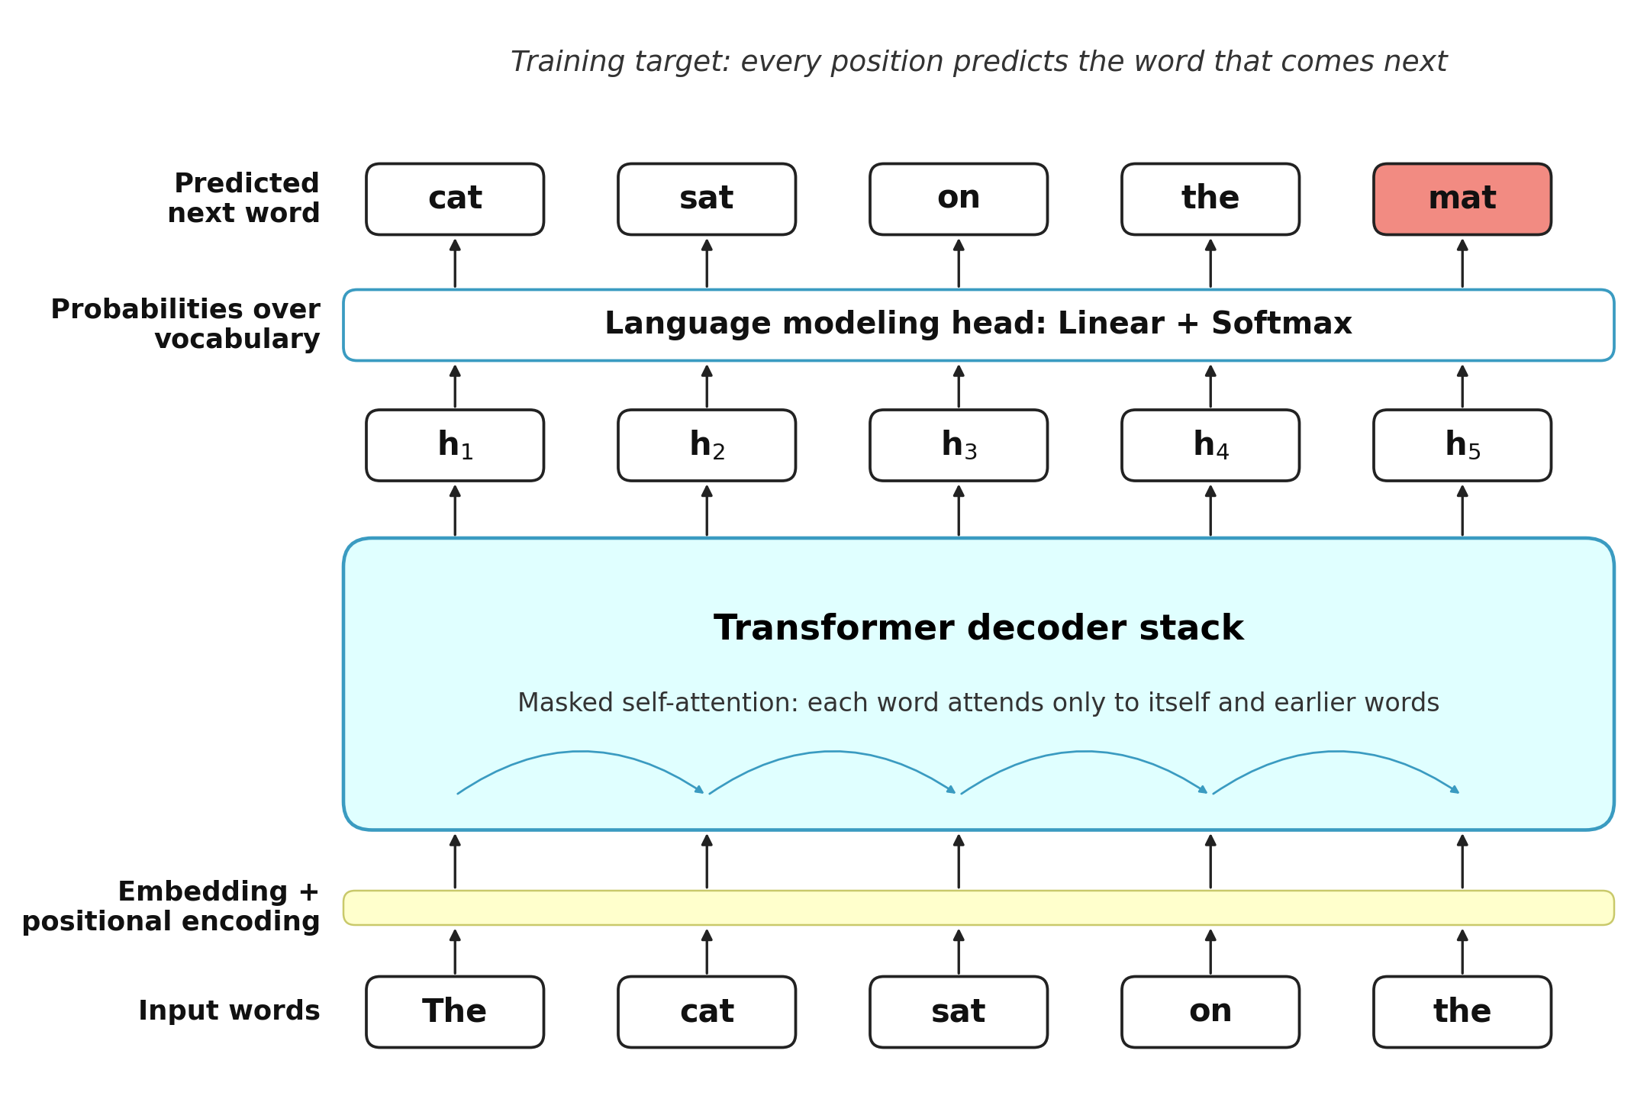
GPT and Causal Language Modeling
A Causal Language Model (CLM) is a type of language model used in the pre-training of models like GPT (Generative Pre-trained Transformer). The working of a CLM is as shown below:
Notes:
Instructor notes:
Walk through the diagram from bottom to top. The input words are embedded, given positional information, and passed through the decoder stack.
At every position, the model outputs a probability distribution over the vocabulary and predicts the next word. For example, after reading “The cat sat on the”, it predicts “mat”.

Slide 42
GPT and Causal Language Modeling
In Causal Language Modeling (CLM), the model reads words from left to right, and a mask hides all future words at each position.
The model attempts to predict the next word at every position by leveraging only the words that come before it.
Notes:
Instructor notes:
Causal Language Modeling works as follows:
1. Masking the future: A causal mask blocks each position from attending to later words, so the model cannot peek ahead.
2. Next-word prediction: At every position, the model predicts the next word, so one sentence provides many training examples.
3. Unidirectional context: Unlike BERT’s MLM, GPT uses only the left context. This makes it weaker at some understanding tasks but ideal for generation.

Slide 43

Use Cases for GPT
Text generation: It creates articles, stories, and marketing copy.
Conversational AI: It powers chatbots and virtual assistants.
Notes:
Instructor notes:
Text generation: GPT can continue a prompt to write articles, stories, emails, or product descriptions.
Conversational AI: GPT-based models power chatbots and virtual assistants that respond naturally in a dialogue.

Slide 44


Use Cases for GPT
Code generation: It writes and completes code from plain-language prompts.
Text summarization: It condenses long documents into short summaries.
Notes:
Instructor notes:
Code generation: Trained on source code, GPT models can write, complete, and explain code from plain-language instructions.
Text summarization: GPT can condense long reports or articles into short summaries when prompted to do so.

Slide 45
Introduction to T5 Model
Notes:
Let’s now look at T5, a transformer model that uses both an encoder and a decoder.

Slide 46
T5 Model
T5 stands for Text-to-Text Transfer Transformer.
It uses the full transformer, with both a trained encoder stack and a decoder stack.
Encoder
Encoder
Encoder
Decoder
Decoder
Decoder
It treats every NLP task as text-to-text: text goes in, and text comes out.
A task prefix, such as “summarize:” or “translate English to German:”, tells the model which task to perform.
Notes:
Instructor notes:
T5 keeps the full encoder–decoder architecture of the original transformer.
Its key idea is the text-to-text format: every task, whether translation, summarization, or classification, is framed as feeding text in and getting text out. A short prefix in the input tells the model which task to perform.

Slide 47
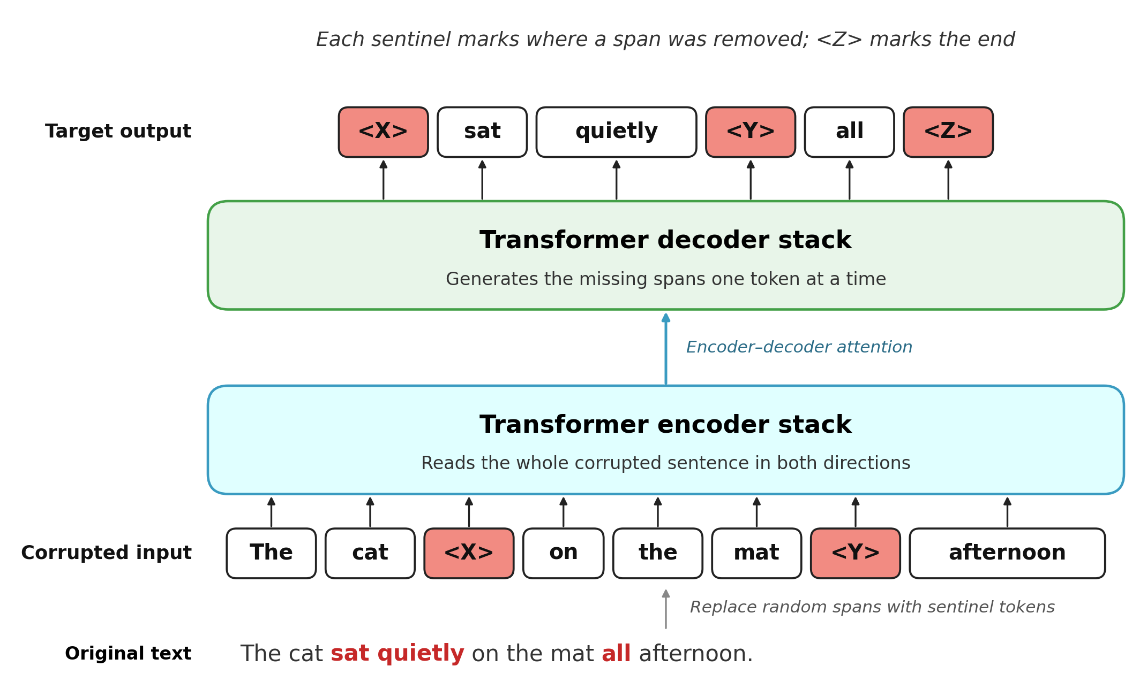
T5 and Span Corruption
Span corruption is the pre-training objective of T5 (Text-to-Text Transfer Transformer). Random spans of words are replaced with sentinel tokens, and the model learns to generate them. It works as shown below:
Notes:
Instructor notes:
Walk through the diagram from bottom to top. Spans of the original sentence are removed and replaced with sentinel tokens such as <X> and <Y>.
The encoder reads the corrupted sentence, and the decoder generates only the missing spans, each introduced by its sentinel token.

Slide 48
T5 and Span Corruption
In span corruption, about 15% of the tokens are removed in short spans, and each span is replaced with a single sentinel token.
The decoder attempts to reconstruct only the missing spans by leveraging the context the encoder captures from the corrupted input.
Notes:
Instructor notes:
Span corruption works as follows:
1. Corrupting spans: About 15% of the tokens are dropped in short, contiguous spans, and each span is replaced with one sentinel token.
2. Shorter targets: The decoder outputs only the missing spans rather than the whole sentence, which makes training efficient.
3. Comparison with BERT: BERT masks single tokens and predicts them in place, whereas T5 removes whole spans and generates them with its decoder.

Slide 49

Use Cases for T5
Machine translation: It translates text from one language to another.
Text summarization: It produces concise summaries of long documents.
Notes:
Instructor notes:
Machine translation: With a prefix such as “translate English to French:”, T5 generates the translated sentence.
Text summarization: With the “summarize:” prefix, T5 produces a short summary of a longer document.

Slide 50
Use Cases for T5
Question answering: It generates answers from a given passage.
Text classification: It outputs labels, such as sentiment, as text.
Notes:
Instructor notes:
Question answering: Given a question and a passage, T5 generates the answer as text.
Text classification: T5 outputs the class label itself as text, for example “positive” or “negative” for sentiment analysis.

Slide 51
Transformers are known for their long-range memory dependencies and acquire this functionality through self-attention.
A transformer architecture comprises two primary components: an encoder and a decoder.
BERT is a transformer model without any decoder module, and it has a trained encoder stack.
In an MLM, 15% of the words are replaced with a MASK token before feeding the sequence of words into BERT.
Notes:
Read the key takeaways.

Slide 52
Notes:
Knowledge check

Slide 53
What major challenges do Transformer models overcome compared to earlier models like RNNs and LSTMs?
1
They reduce the computational time for each task.
They excel at capturing long-range dependencies.
They require less data for training.
They eliminate the need for attention mechanisms.
B
Transformer models effectively address the challenge of long-range dependencies that earlier models like RNNs and LSTMs struggled with due to their use of self-attention mechanisms.

Slide 54
In the Transformer Model Architecture, what is the primary role of the encoder and decoder components?
2
The encoder processes input sequences into a fixed format, and the decoder directly outputs translated text.
The encoder generates an output sequence, and the decoder predicts the next word in the input sequence.
The encoder processes input sequences and integrates information using self-attention, and the decoder generates the output sequence based on this contextual information.
The encoder and decoder function independently to translate sentences without sharing information.
C
The encoder processes input sequences and integrates information using self-attention, and the decoder generates the output sequence based on this contextual information.

Slide 55
Thank You!
Notes:
Thank you

